Slide 1
DevOps culture practices
Notes:
Author: Ahmed Hosni
1

Slide 2
Agenda
Part 1:
IaC: The Big Picture
Create immutable infrastructure using Packer
Configuration Management using Ansible
Workshop
Part 2:
SRE Culture
Practical Alerting from Time-Series Data
Postmortem Culture Learning from Failure
SRE Emergency Procedures
Workshop
2

Slide 3
IaC: The Big Picture
Notes:
Author: Ahmed Hosni
3

Slide 4
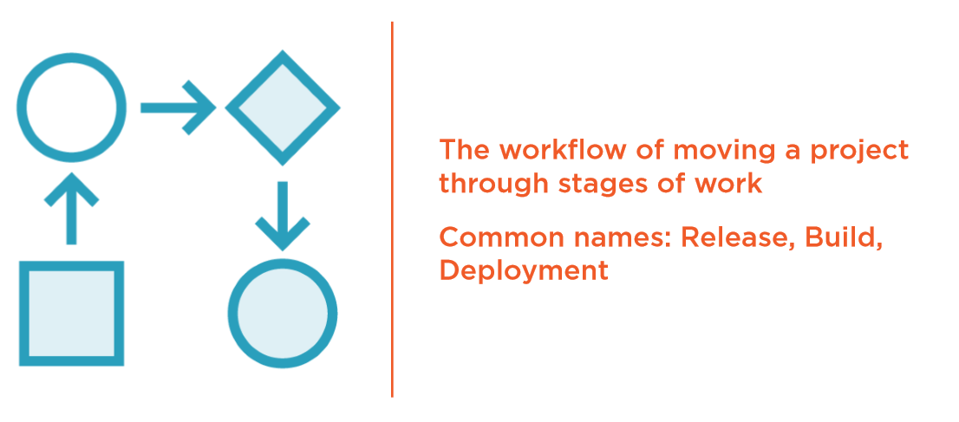
IaC: The Pipeline

Slide 5
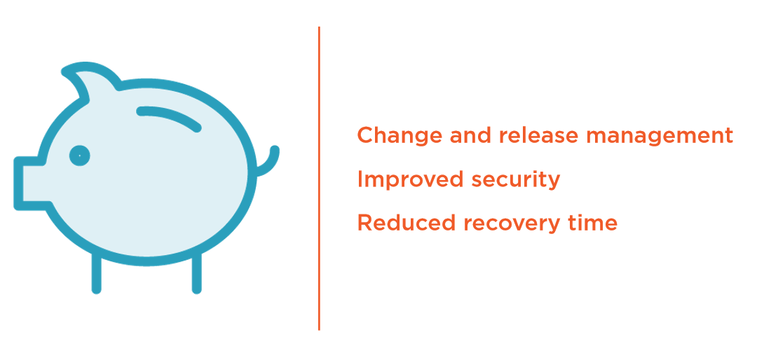
The Saving to Business and Customers

Slide 6
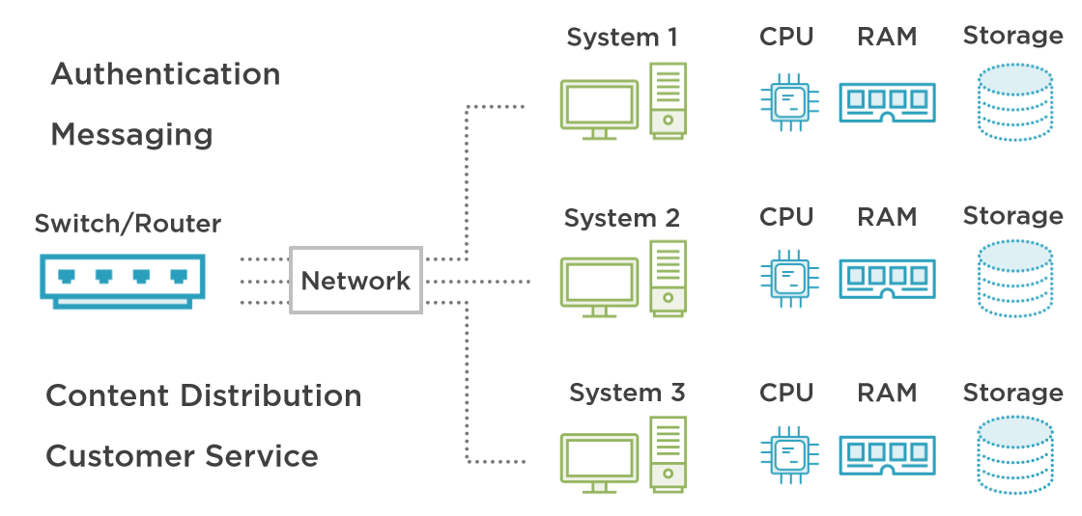
The Saving to Business and Customers

Slide 7
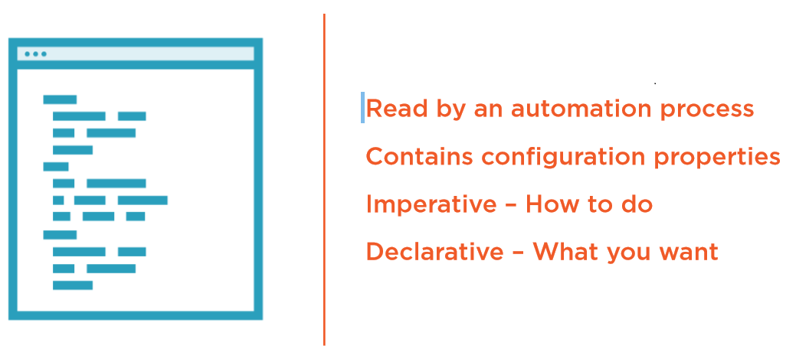
The Configuration

Slide 8
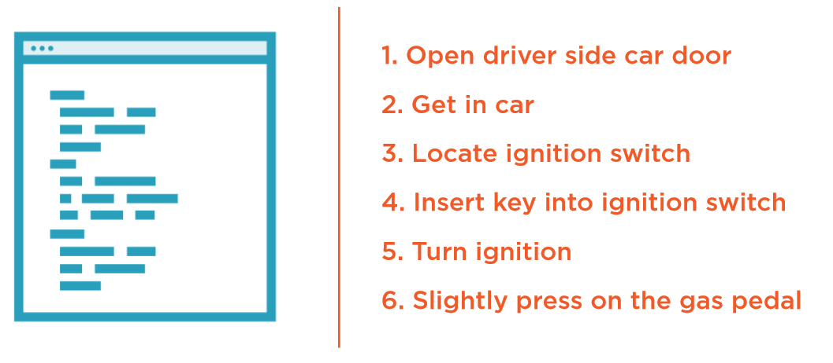
Imperative – Starting a Car

Slide 9
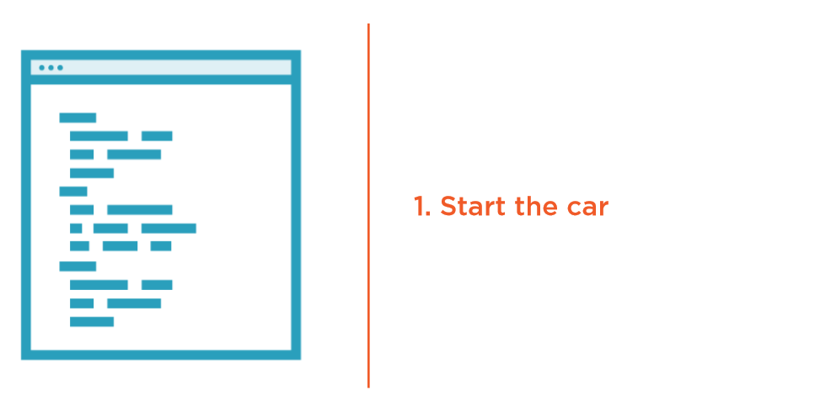
Declarative – Starting a Car

Slide 10
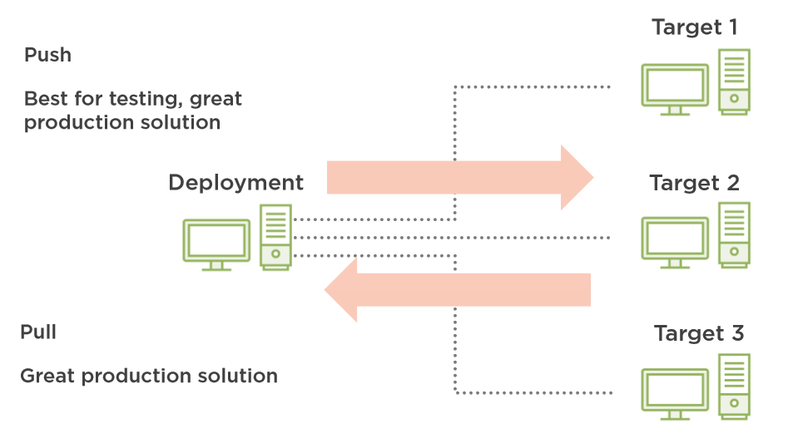
Push/Pull Target Delivery

Slide 11
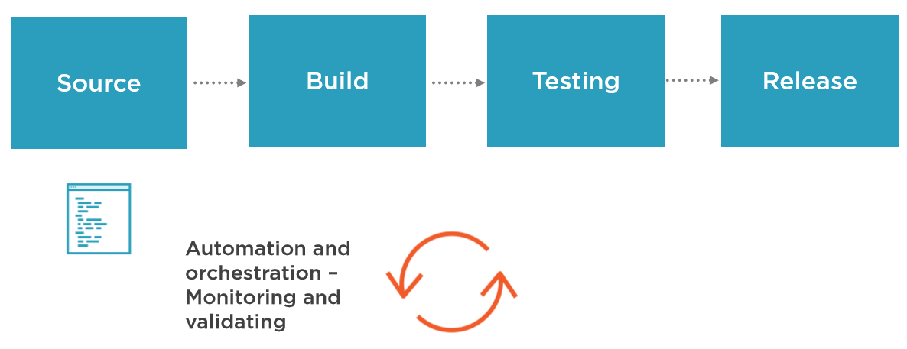
Push/Pull Target Delivery

Slide 12
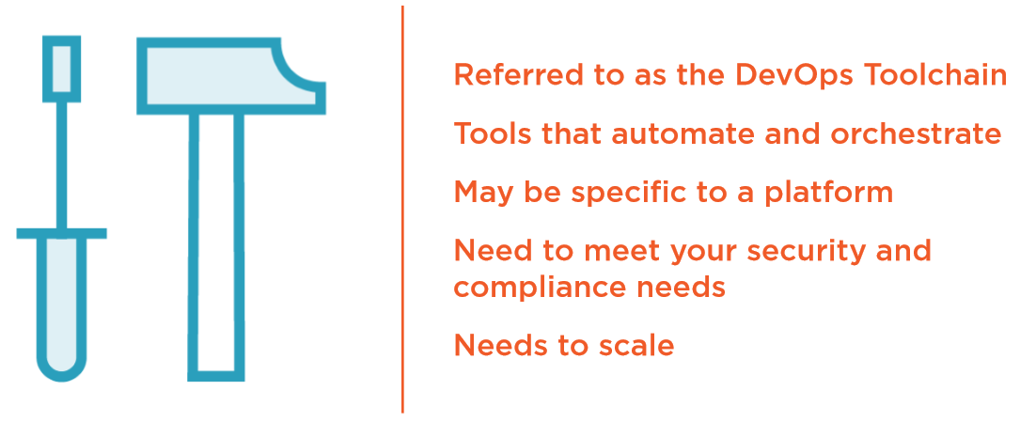
Continuous Configuration Automation (CCA) Tools

Slide 13
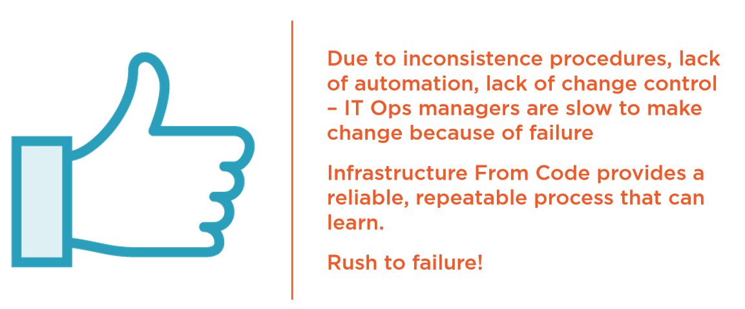
A New View of “Failure”

Slide 14

What Does Release Mean?

Slide 15


The Release Pipeline

Slide 16
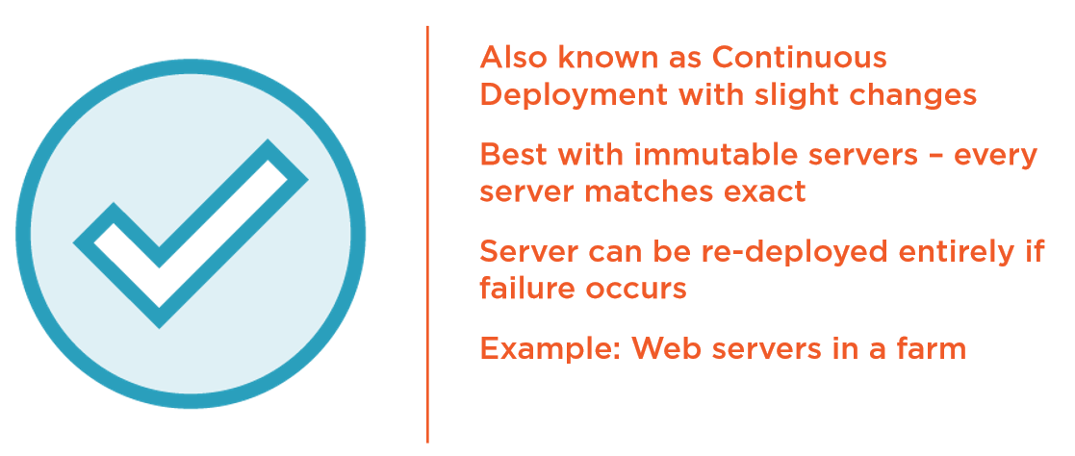
Continuous Delivery (CD)

Slide 17
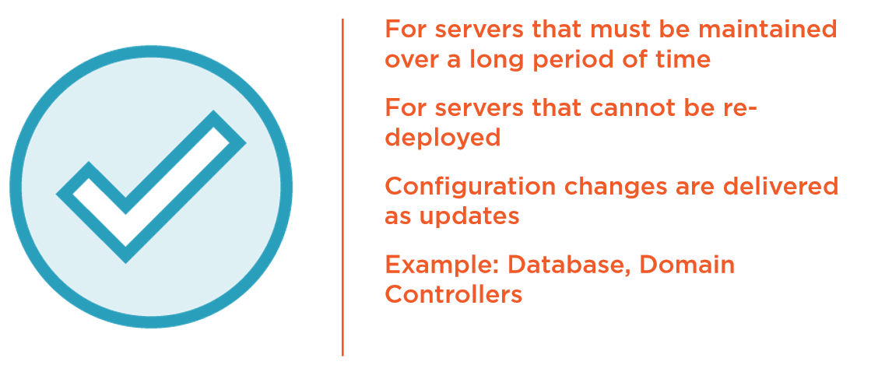
Incremental Deployment

Slide 18
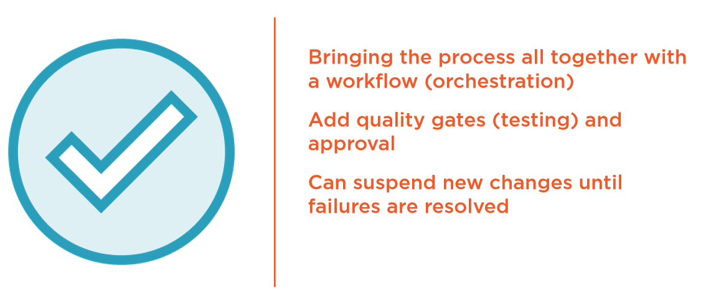
Continuous Integration

Slide 19
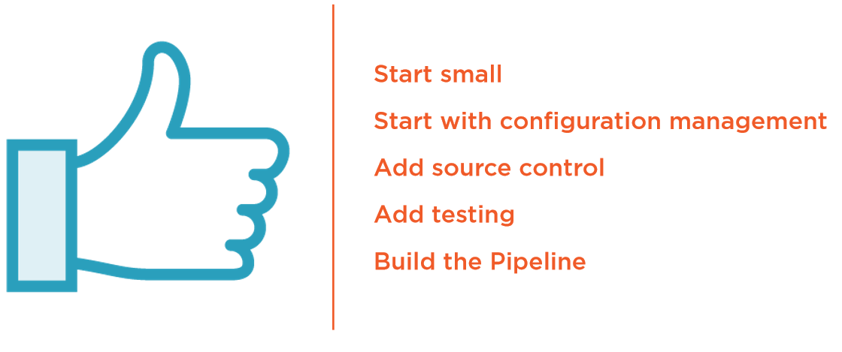
Getting Started – Infrastructure as Code

Slide 20
Create immutable infrastructure using Hashicorp Packer
Notes:
Author: Ahmed Hosni
20

Slide 21
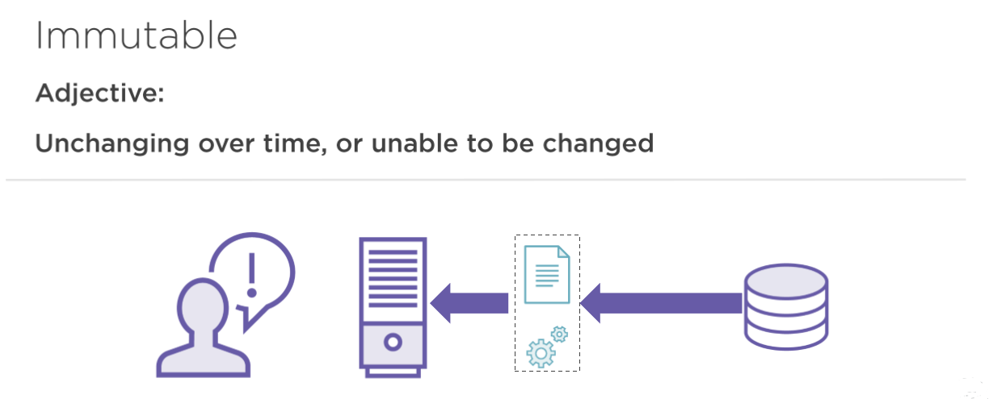
Immutable Infrastructure

Slide 22
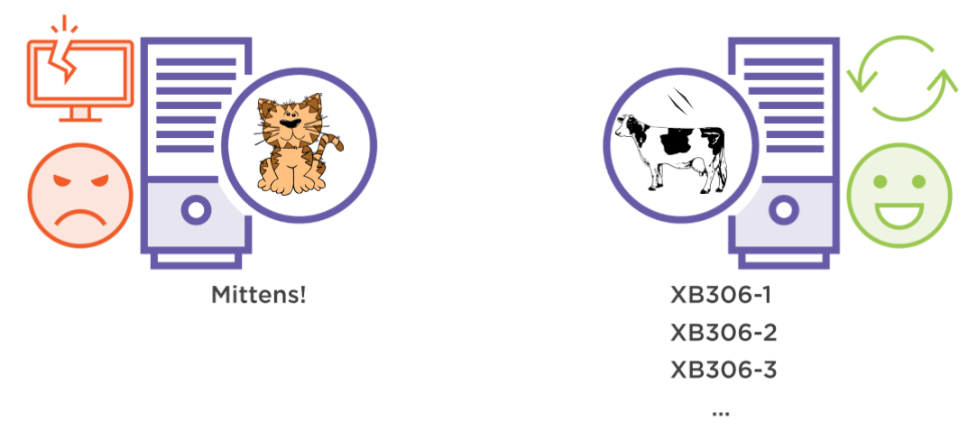
Pets and Cattle

Slide 23
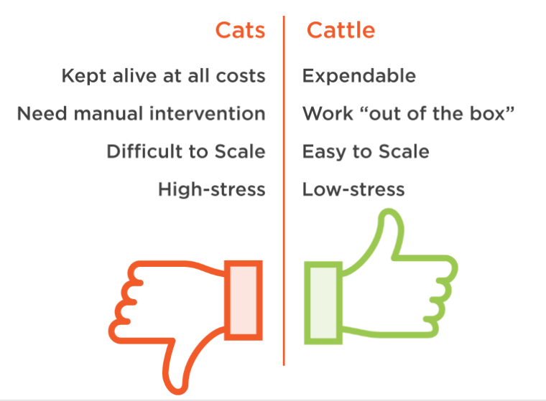
Pets and Cattle

Slide 24
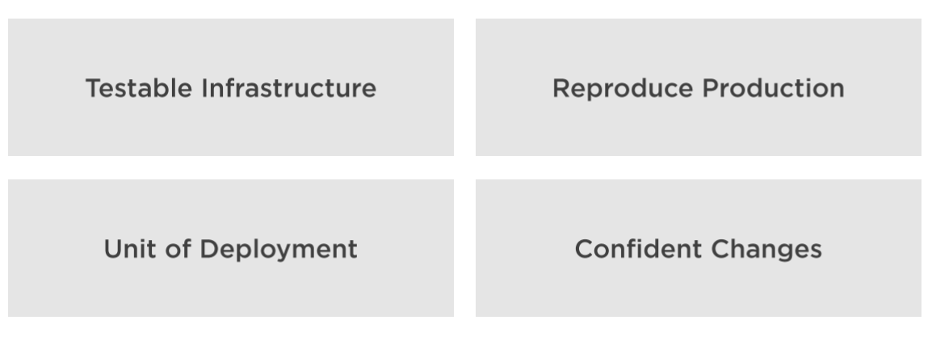
Other benefits

Slide 25


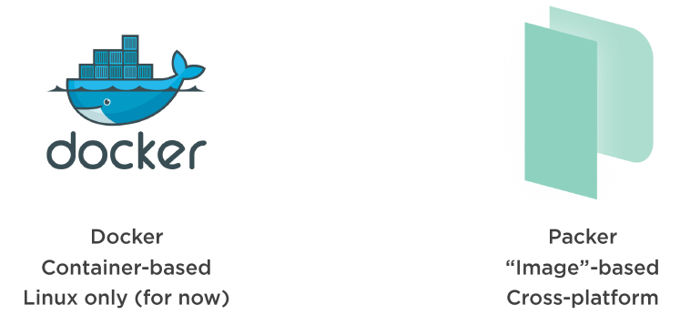
When to use it? How?

Slide 26
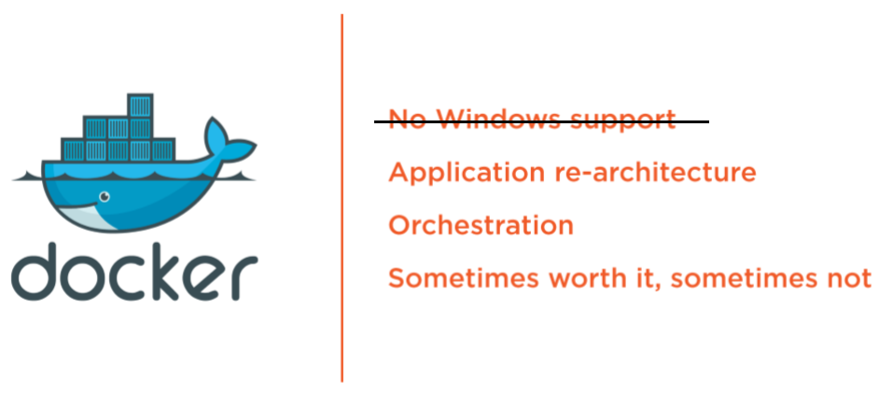
Docker?

Slide 27
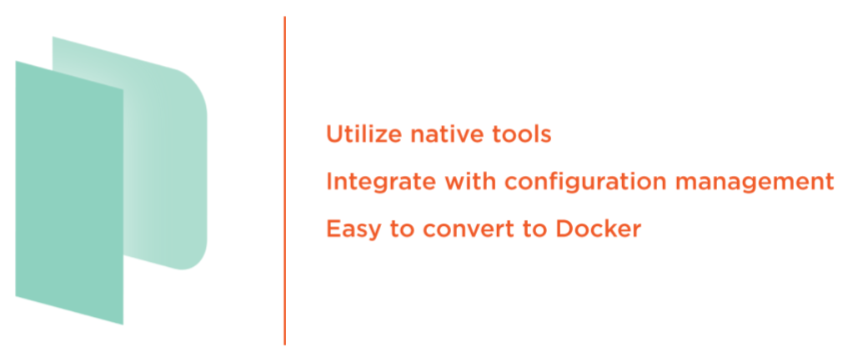
Packer!

Slide 28
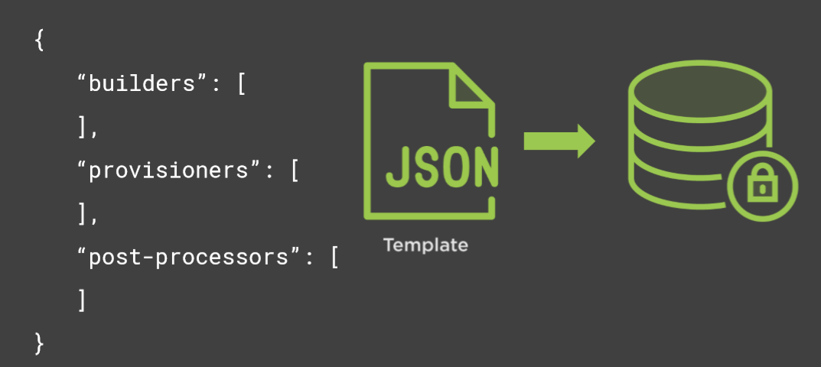
A Packer Template

Slide 29
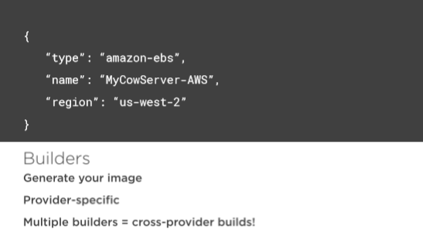
A Packer Template

Slide 30
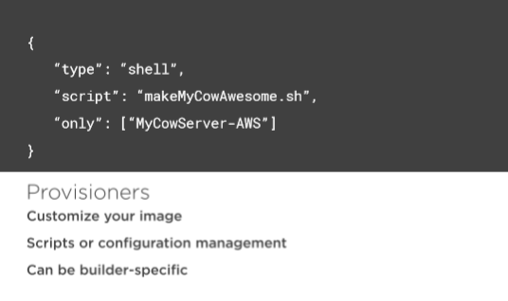
A Packer Template

Slide 31
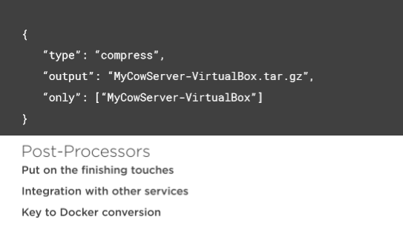
A Packer Template

Slide 32
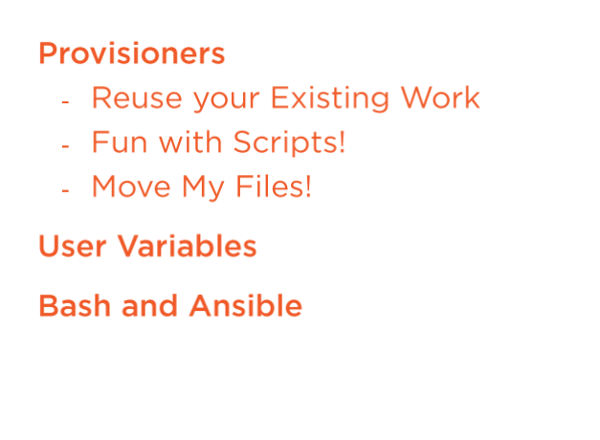
Provisioners

Slide 33
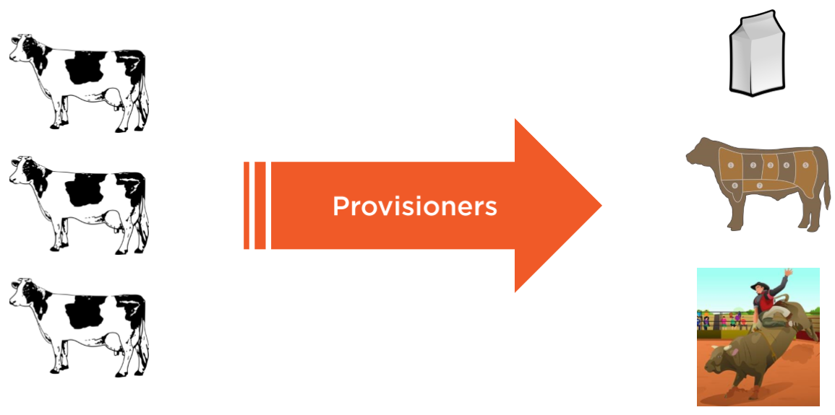
Provisioners

Slide 34
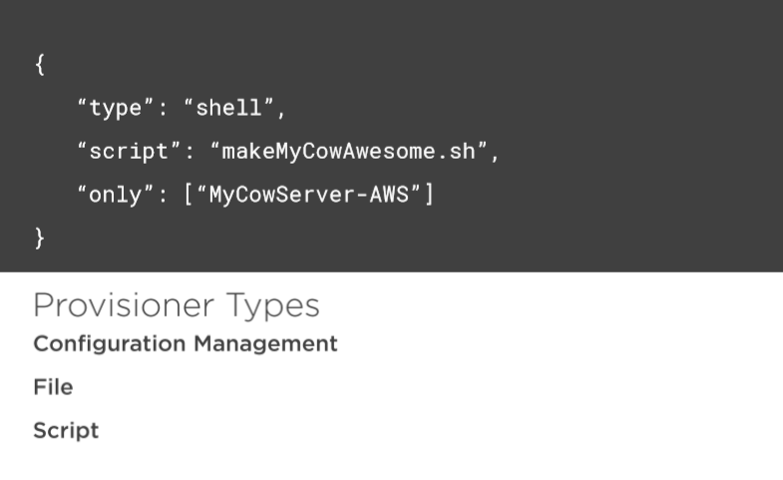
Provisioners

Slide 35
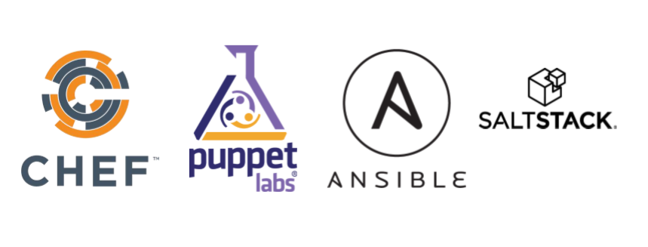
Configuration Management Provisioners

Slide 36
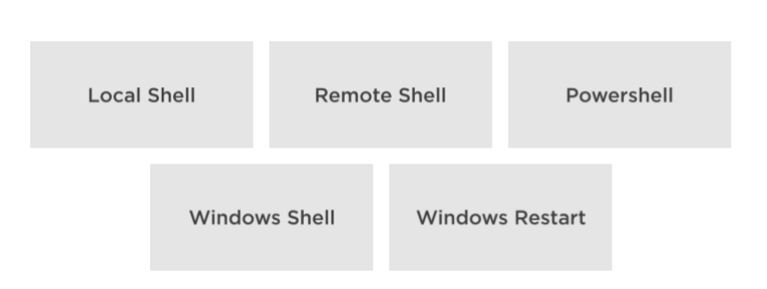
Script Provisioners

Slide 37
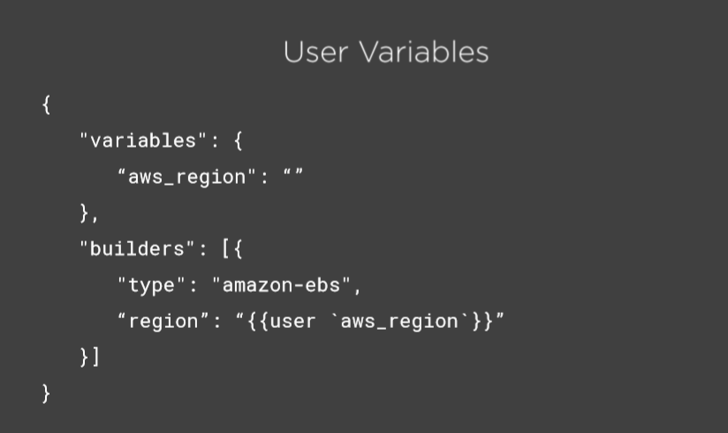
Variables

Slide 38
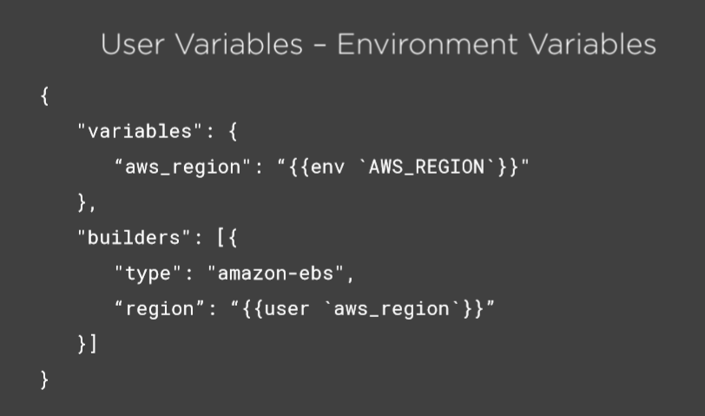
Variables

Slide 39
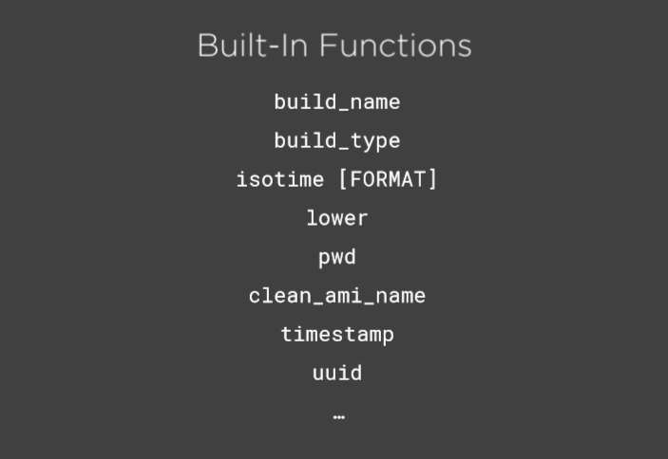

Slide 40
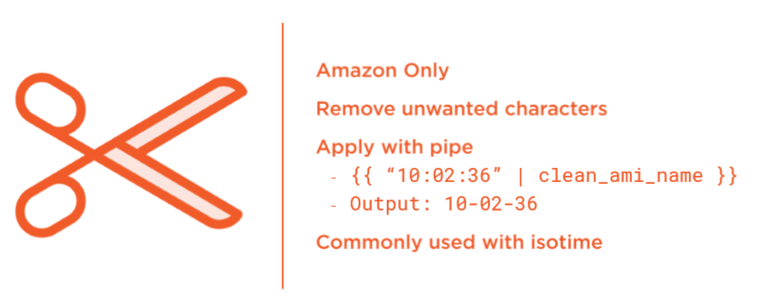
clean-ami-name

Slide 41
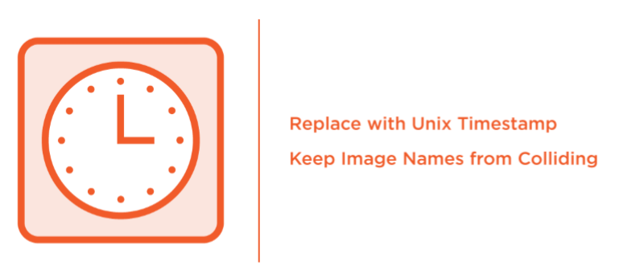
Timestamp

Slide 42
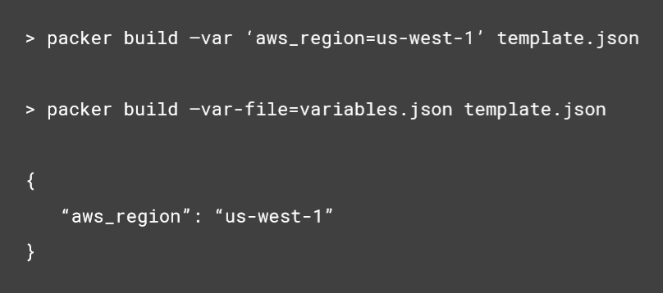
User Variables - Setting

Slide 43

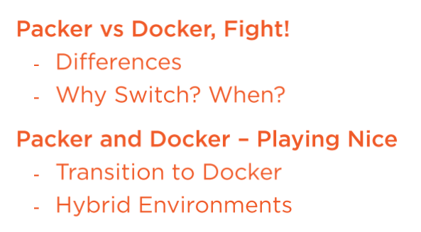
Transitioning from Packer to Docker

Slide 44
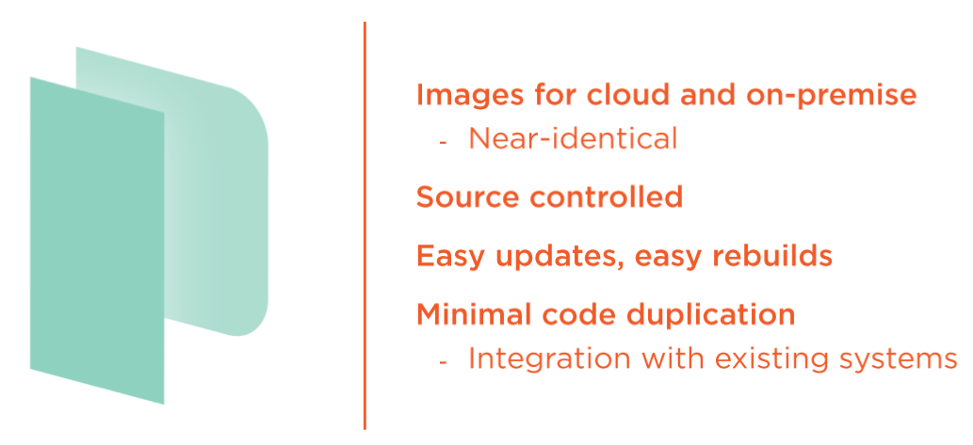
Packer - What We've Got so far

Slide 45
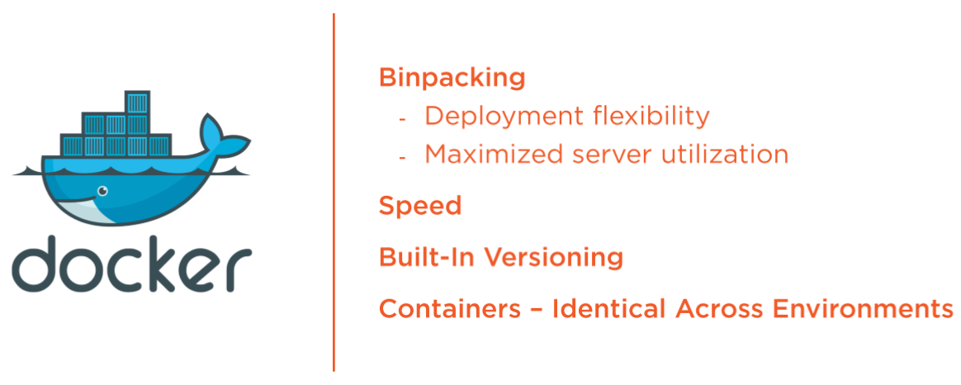
Docker - What Else Do you Get?

Slide 46
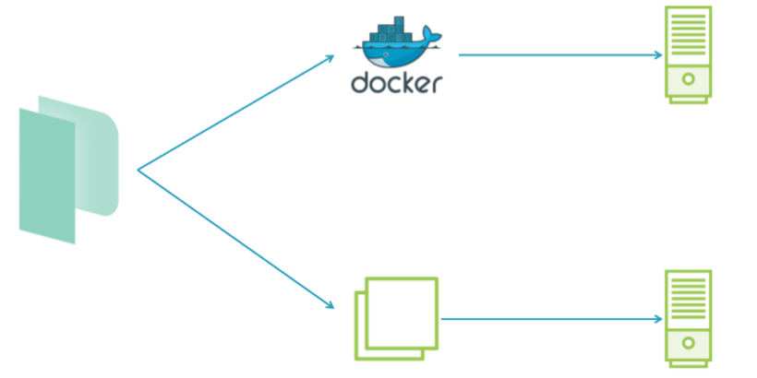
Packer - Hybrid Builds

Slide 47
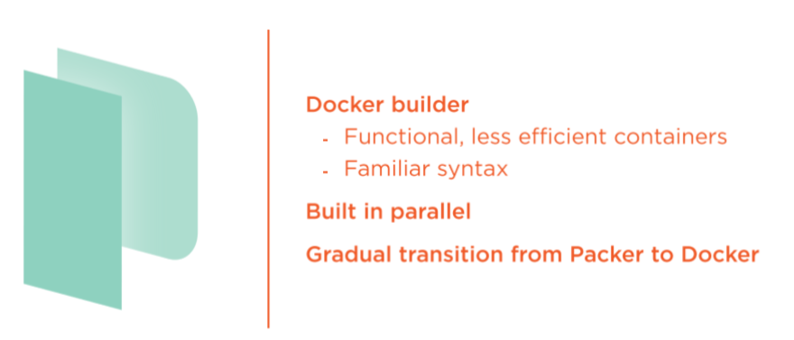
Packer - Hybrid Builds

Slide 48

DEMO
- Install Packer
- Command Line Options
- Basic Packer Template:
- Ubuntu 18.04 LTS
- Your First Cow Server!

Slide 49
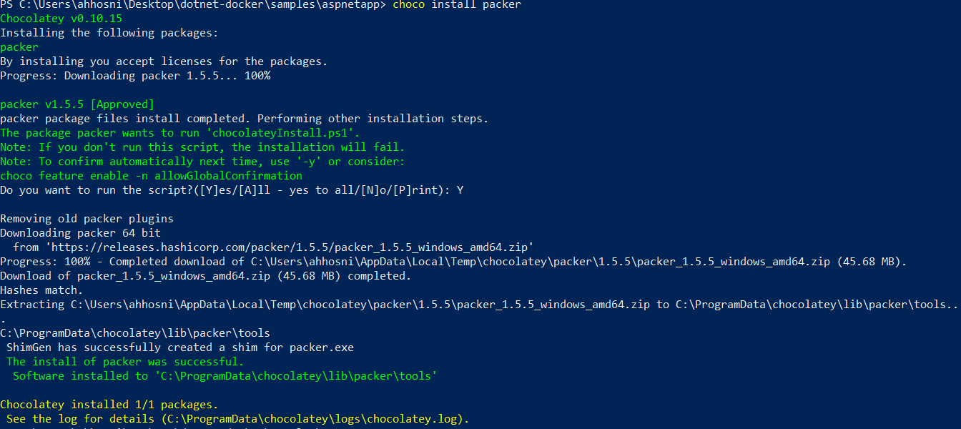
Install > choco install packer
Notes:
https://chocolatey.org/packages/packer

Slide 50
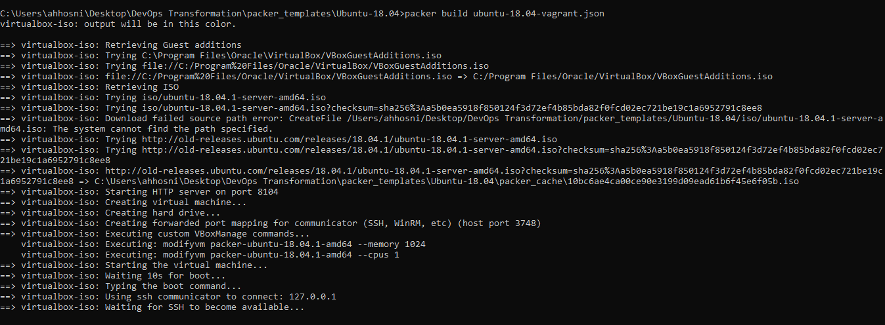
Basic Packer Template

Slide 51
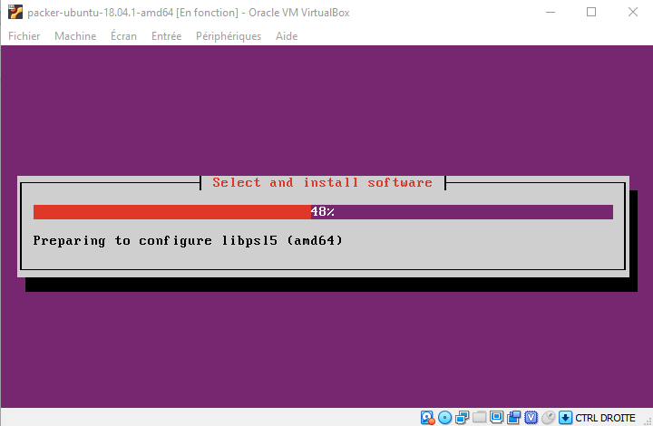
Basic Packer Template

Slide 52
Configuration Management using Ansible

Slide 53
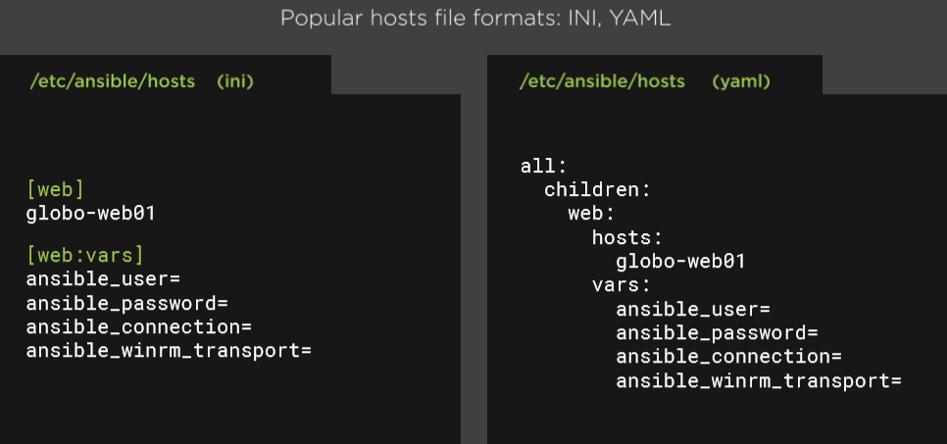
Implementing Ansible Inventory

Slide 54
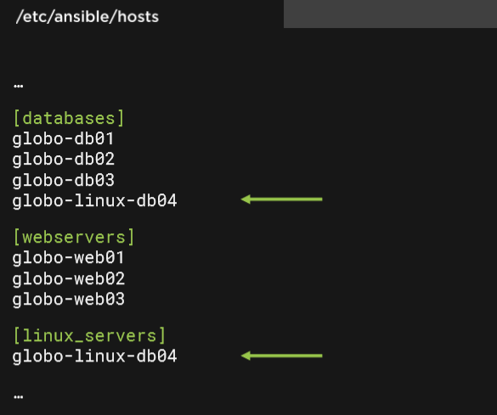
Ansible Groups

Slide 55
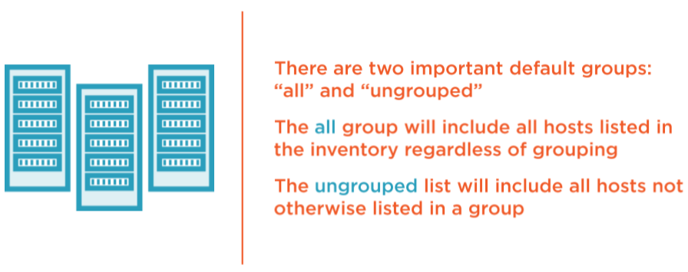
Ansible Default Groups: All, Ungrouped

Slide 56
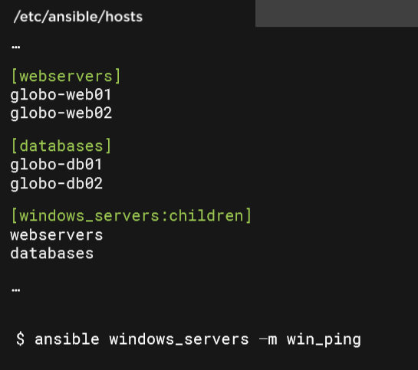
Nested Groups

Slide 57
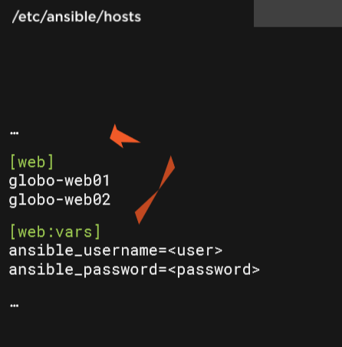
Ansible Variables

Slide 58
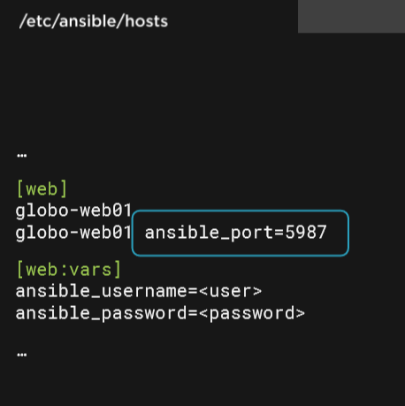
Overriding variables

Slide 59

Nested Group Variables

Slide 60

Ansible Comes with Many Modules

Slide 61

Ansible Comes with Many Modules

Slide 62

Modules Are Idempotent

Slide 63

The gather_facts Module

Slide 64

Let's Talk About Playbooks

Slide 65

Playbooks are often stored in SCM

Slide 66

The Play

Slide 67

Hosts

Slide 68

Variables

Slide 69

Tasks

Slide 70

Tasks

Slide 71

State of Things

Slide 72
Writing Ansible playbooks
Playbooks are essentially sets of instructions (plays) that you send to run on a single target or groups of targets (hosts).
For this example, the target host will be a RHEL/CentOS 7 base install.
There will be a web server installed (NGINX) and then an index.html file will be created in the default webroot.
After the install and file tasks are completed the service will be started.

Slide 73

Writing Ansible playbooks
Playbooks start with the YAML three dashes (---) followed by:
Name: good for keeping the Playbooks readable
Hosts: identifies the target for Ansible to run against
Become statements: true statement is included here to ensure nginx installs without a problem (it's not always required)

Slide 74

Writing Ansible playbooks
The state:
Present statement lets Ansible check the state on the target first before performing any further action.
In both cases if the repo or package is already present, Ansible knows it doesn't have to do any more for this task and continues.

Slide 75


Writing Ansible playbooks
Insert the index page in the default NgInx location
The last thing the Playbook will do is make sure that the nginx service has been started (and if not, start it).

Slide 76

Writing Ansible playbooks

Slide 77

Writing Ansible roles

Slide 78

Ansible Role Folder Structure

Slide 79

The Meta Folder

Slide 80

The Task Folder

Slide 81

Other Ansible Role Folders

Slide 82

Ansible Templates with Jinja2

Slide 83
Demo using Ansible Role

Slide 84

Create an Ansible Role
Begin by creating a new role using ansible-galaxy.
We will use the --offline option so we do not query the galaxy API
Run: ansible-galaxy init axefinance-role --offline
Notes:
https://galaxy.ansible.com/docs/contributing/creating_role.html

Slide 85

Ansible Galaxy
Notes:
Try:
> ansible-galaxy install geerlingguy.jenkins

Slide 86
Workshop Ansible 101
Notes:
https://github.com/m2i-training/ansible-101

Slide 87


Setting the Ansible with Docker

Slide 88

Create a Docker container embedding Ansible

Slide 89
Bootstrap Ansible LAB
To bootstrap this lab environment, execute init script, it will perform the following tasks:
Delete previous 3 containers Debian, Ubuntu et Centos
Create an RSA key allowing Ansible connection through SSH
Starting 3 instances Docker Debian, Docker Ubuntu, and Docker Centos
Ssh key injection in each Docker instance using ssh-copy-id (password will be ask: toor)
Ansible hosts inventory creation

Slide 90

Bootstrap Ansible LAB

Slide 91

Check connectivity
We check that all the nodes are reachable by Ansible using the following command:
> docker run -it --rm -v `pwd`/hosts:/etc/ansible/hosts -v `pwd`/id_rsa:/root/.ssh/id_rsa itwars/ansible-cli all -m ping
Here is some details about the params:
Ansible needs a hosts inventory file (generated by the init script).
The Ansible container needs the private key to connect to the nodes (generated by the init script).
Ansible is invoked with the params "all -m ping": we apply the ping module to all nodes

Slide 92

Installing a service with Ansible
Let's ask Ansbile to install Nginx service on the "debian" node:
> docker run -it --rm -v `pwd`/hosts:/etc/ansible/hosts -v `pwd`/id_rsa:/root/.ssh/id_rsa itwars/ansible-cli debian -m apt -a "name=nginx state=present"

Slide 93

Starting a service with Ansible
Let's ask Ansbile to start Nginx service on the "debian" node:
> docker run -it --rm -v `pwd`/hosts:/etc/ansible/hosts -v `pwd`/id_rsa:/root/.ssh/id_rsa itwars/ansible-cli debian -m service -a "name=nginx state=started"

Slide 94

Retrieve the setup of a node with Ansible
> docker run -it --rm -v `pwd`/hosts:/etc/ansible/hosts -v `pwd`/id_rsa:/root/.ssh/id_rsa itwars/ansible-cli debian -m setup

Slide 95
SRE Culture

Slide 96

Not that far away maybe in a company just like yours…

Slide 97

97

Slide 98

What changed?

Slide 99


Principles of SRE are what set SRE apart
Notes:
https://www.youtube.com/watch?v=c-w_GYvi0eA&feature=youtu.be

Slide 100

SLO and Error Budgets: Tools for Shared Responsibility

Slide 101

SLO and Error Budgets: Tools for Shared Responsibility

Slide 102

Toil: Name For a Problem We’ve All Felt

Slide 103

Toil vs. Engineering Work

Slide 104

Excessive Toil Prevents Fixing the System

Slide 105

Toil is a naturally occurring force

Slide 106

Where to start?
Notes:
Why focus on reducing toil?
Lots of value independent of “SRE”
Your people are you most expensive assets … stay out of their way!

Slide 107

Your people are expensive stay out of their way!
Notes:
The OODA loop (Observe, Orient, Decide, Act) is a four-step approach to decision-making that focuses on filtering available information, putting it in context and quickly making the most appropriate decision while also understanding that changes can be made as more data becomes available.

Slide 108



Ticket queues: Interruptions, waiting, and toil

Slide 109

Super easy to get started

Slide 110

Where to focus

Slide 111

Self-Service Operations Design Pattern (in a nutshell)

Slide 112

Self-Service is ultimately about user experience

Slide 113

“Do it, do it again, then do it again.”

Slide 114

“I could fix it, but I can’t get to it.”

Slide 115

“I’m an expert, I don’t read the wiki.”

Slide 116

“Known issue… doesn’t get permanent fix”

Slide 117

Avoid culture of heros

Slide 118


Recap: Make Tomorrow Better Than Today

Slide 119
Case study

Slide 120

Real-World DevOps Experiences from a 165-year Old Bank Standard Chartered Bank

Slide 121

Real-World DevOps Experiences from a 165-year Old Bank Standard Chartered Bank

Slide 122
Practical Alerting from Time-Series Data

Slide 123

“The Happy Developer”

Slide 124

Disaster Strikes

Slide 125

Logging vs Monitoring

Slide 126


Slide 127

Why Monitoring?

Slide 128

What to monitor?

Slide 129

We have Storage problem!

Slide 130

Time Series - Database

Slide 131

Time Series - Data format

Slide 132
DB-Engines Ranking of Time Series DBMS
Notes:
https://db-engines.com/en/ranking/time+series+dbms

Slide 133

Instrumenting your own code!
Notes:
In statistics and probability quantiles are cut points dividing the range of a probability distribution into continuous intervals with equal probabilities,
https://en.wikipedia.org/wiki/Percentile

Slide 134

Prometheus Overview

Slide 135

Prometheus Components

Slide 136

Prometheus Components

Slide 137

Pull vs Push

Slide 138

Exporters

Slide 139

Common exporters

Slide 140

Grafana

Slide 141

Alerting Configuration

Slide 142

Alerting Configuration

Slide 143

Alerting Configuration

Slide 144

Alerting Configuration

Slide 145

Instrumenting your own code!

Slide 146

Prometheus Client Libaries SpringBoot Example

Slide 147
Workshop Monitoring stack with Grafana and InfluxDB on K8S

Slide 148
Setup the monitoring stack
InfluxDB is a time series database optimized for high-availability storage and rapid retrieval of time series data.
To visualize the collected metrics, we'll use Grafana.
We will use Helm charts to install both the InfluxDB and Grafana packages. To use Helm, we first need the Helm client itself:
$ choco install kubernetes-helm

Slide 149
Setup the monitoring stack
The next step is to use Helm to install charts for Grafana and InfluxDB:
$ helm repo add stable https://kubernetes-charts.storage.googleapis.com/
$ helm install stable/influxdb --name-template influxdb
$ helm install stable/grafana --name-template grafana

Slide 150
Setup the monitoring stack
Change the grafana service type from ClusterIp to NodePort:
$ kubectl delete svc grafana
$ kubectl expose deployment grafana --type=NodePort
Retrieve the service url:
$ minikube service grafana
Fetch the Grafana dashboard credentials:
$ kubectl get secret grafana -o jsonpath='{.data.admin-password}' | base64 --decode

Slide 151

Grafana dashboard

Slide 152
Postmortem Culture Learning from Failure

Slide 153

Workarounds…

Slide 154

The goals of a postmortem are to understand all contributing root causes, document the incident for future reference and pattern discovery, and enact effective preventative actions to reduce the likelihood or impact of recurrence.

Slide 155
What is postmortem?
A postmortem is a written record of an incident that describes:
The incident’s impact.
The actions taken to mitigate or resolve the incident.
The incident’s causes.
Follow-up actions taken to prevent the incident from happening again.

Slide 156
Postmortem process overview
For postmortems to be effective, the process has to make it easy for teams to identify causes and fix them..
Postmortems should not be restricted/limited to only technical issues (outages, technical incidents, failures), because otherwise we miss a lot of valuable information from other areas that are helpful for continuous improvement.
Template: https://github.com/dastergon/postmortem-templates/blob/master/templates/postmortem-template-srebook.md

Slide 157
Postmortem process overview
They should also include situational issues we might encounter like:
Communication problems.
Conflicts.
Anything you can learn from.
It is VERY IMPORTANT when writing them to:
Use blameless language.
Be annonymous without fingerpointing.
Be constructive.

Slide 158
Which information should a postmortem contain?
An overview to provide context.
A description of the problem (what happened?).
The root cause (Why it happened?).
A resolution (How we solved the issue).
A lesson learned.

Slide 159
Which information should a postmortem contain?
Some other extra information that could be useful to include:
Screenshots.
Tickets.
Charts.
Timelines.
External feedback.

Slide 160
Tooling requirements
Incident tracking
Chat room
Video chat
Alerting system
Documentation tool
Statuspage
Notes:
Incident tracking: every incident is tracked as an issue, with a follow-up issue created to track the completion of postmortems.
Chat room: a real-time text communication channel that is fundamental to diagnosing and resolving the incident as a team.
Video chat: for many incidents, team video chat tools can help to discuss and agree on approaches.
Alerting system: a tool that manages on-call rotations and escalations.
Documentation tool: use a tool for incident state documents and sharing postmortem via blogs.
Statuspage: communicating status with both internal stakeholders and customers through Statuspage helps keep everyone in the loop.

Slide 161

Public postmortems?
https://about.gitlab.com/blog/2017/02/10/postmortem-of-database-outage-of-january-31/
Notes:
More postmortems:
A bad config (router rule) caused all of their edge routers to crash, taking down all of Cloudflare:
https://blog.cloudflare.com/todays-outage-post-mortem-82515/
A bad config took down both Facebook and Instagram:
https://blog.thousandeyes.com/facebook-outage-deep-dive/
A bad config took down Azure storage:
https://azure.microsoft.com/en-us/blog/update-on-azure-storage-service-interruption/
*

Slide 162

Replay postmortem scenarios as training

Slide 163
SRE Emergency Procedures

Slide 164

Context: Launching new features vs reliability

Slide 165

Context: Launching new features vs reliability

Slide 166

Path towards high availability

Slide 167

Quiz: I want my service availability to be … ?

Slide 168

Right answer

Slide 169

Deciding on right availability target answer

Slide 170

Service Level Indicators

Slide 171


Service Level Objectives (SLOs)

Slide 172

Expected downtime

Slide 173

Error Budget

Slide 174

Life of an incident

Slide 175

Life of an incident

Slide 176

Life of an incident

Slide 177

Life of an incident

Slide 178

Life of an incident

Slide 179

Recap

Slide 180
Questions?

